Slide 1
Bootcamp 2020: First years

Slide 2
AIM
Students should be able to utilise SU online services effectively.
At the end of the session, students should be able to:
use My.Sun (Manage Password, Web email, Office 365);
download SUNLearn App;
enrol for Student Training module on SUNLearn;
login on SUNLearn;
conscientise about Information Security.

Slide 3
LOGIN ON SUNLEARN
Type www.learn.sun.ac.za
Type your Student number
Type your Password
Click Sign In (Press Enter)
Click Site Home
Scroll to the bottom, search Student Training Course (Self enrolment Course)
Click Dashboard to go back to your modules
Under Course Overview, click In Progress

Slide 4
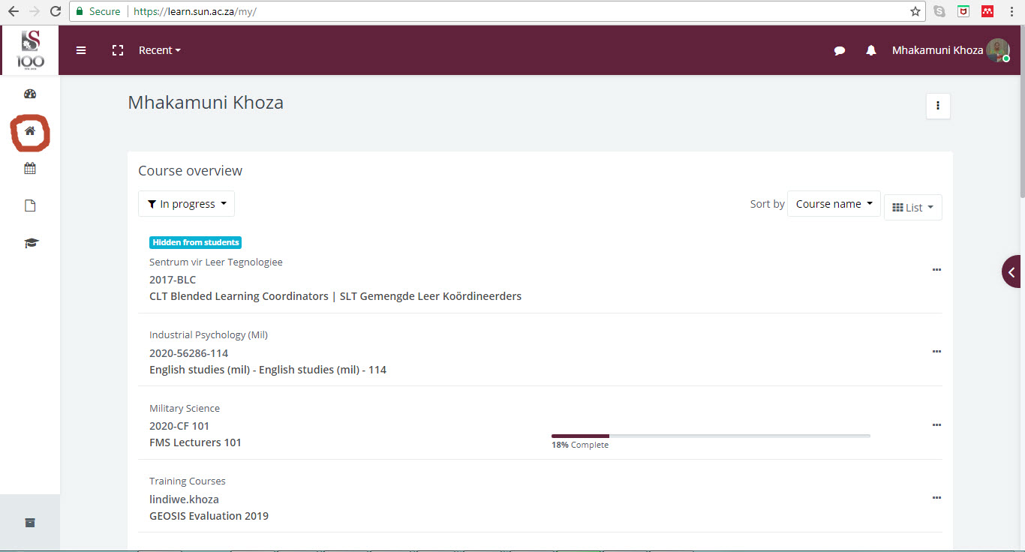
SELF ENROLMENT STUDENT TRAINING COURSE

Slide 5
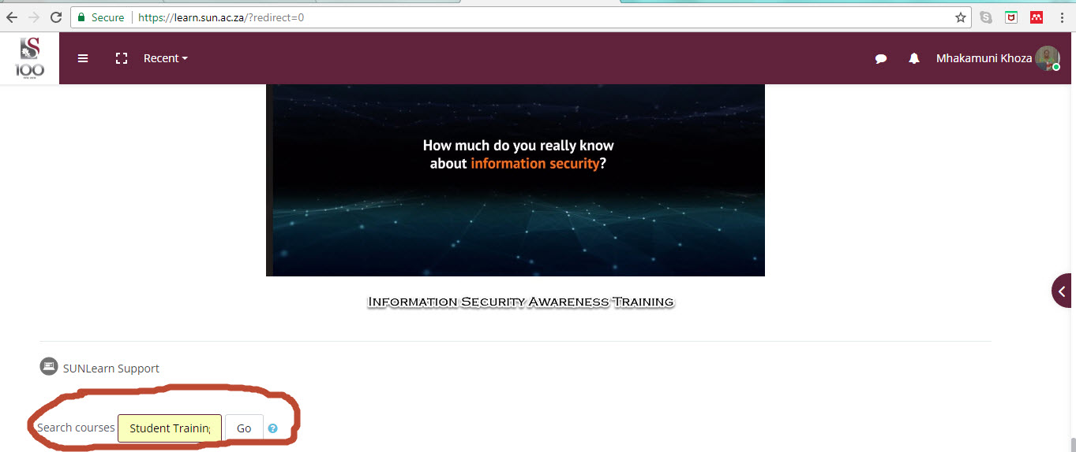
SELF ENROLMENT STUDENT TRAINING COURSE

Slide 6
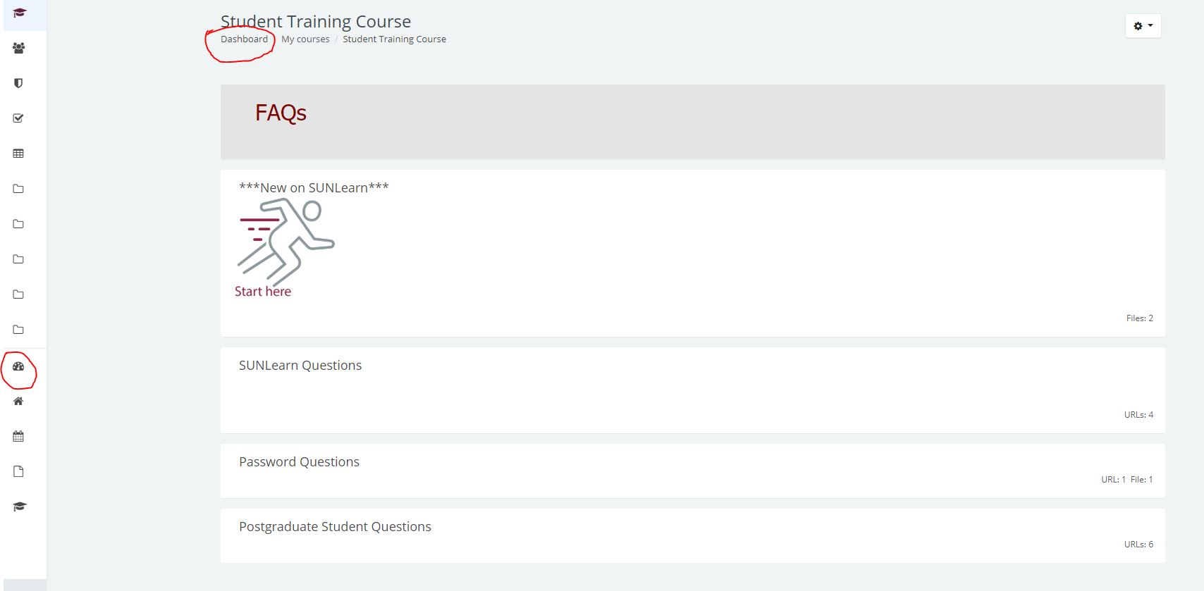
SELF ENROLMENT STUDENT TRAINING COURSE

Slide 7
LOGIN ON SUNLEARN
To login on SUNLearn: www.learn.ac.za
Click log in on the left corner.
Type your Student number in the Username textbox.
Type your Password in the Password textbox.
Click Sign In (Press Enter).
To access your current modules, select In Progress under Course Overview

Slide 8
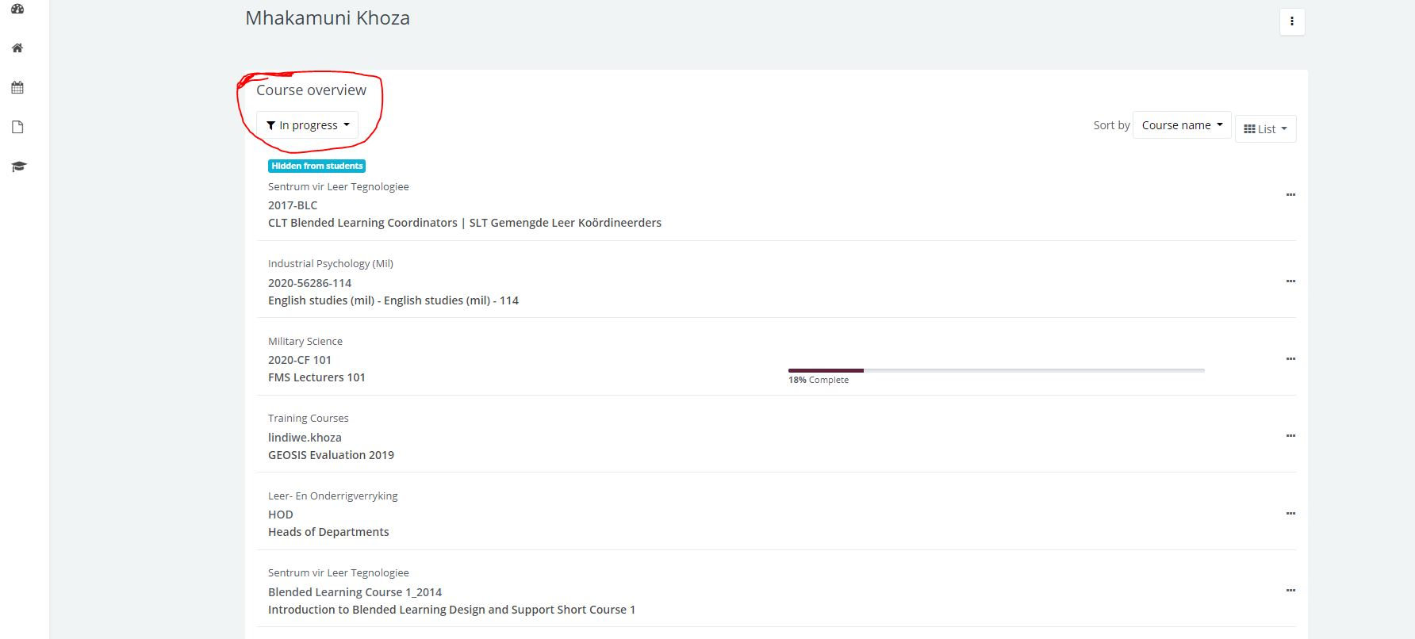
ACCESS TO CURRENT MODULES

Slide 9
CHANGE SUN EMAIL TO PERSONAL EMAIL
Click your name;
Click edit profile;
Delete sun email and type your functional personal email address;
Click update
Click Continue;
You will receive an email in your personal email;
Click the link on personal email to confirm that you requested to change the email.
Log out when finished reading your emails.

Slide 10
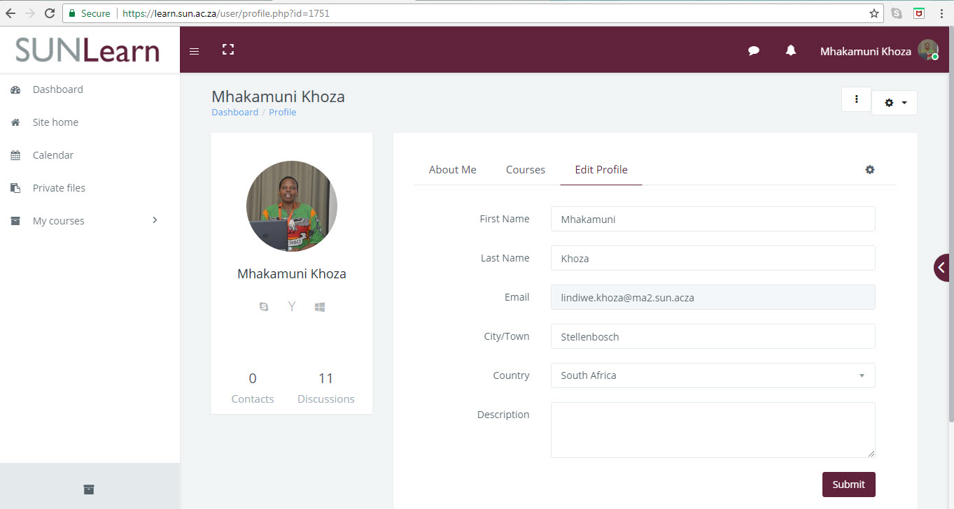

Slide 11
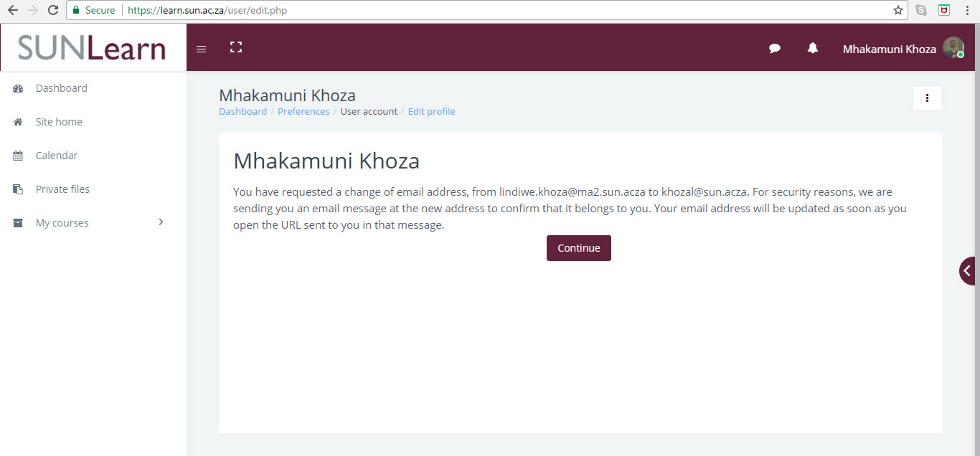

Slide 12
OFFICE 365: WEBMAIL
Type http://www.sun.ac.za/Home.aspx
Click My.SUN
Click Web E-mail
Click Outlook Cloud Email ( Office 365)
Type your SUN email address: 12345678@sun.ac.za
Type your password
Follow the prompts (Country: SA, Time Zone: Harare-Pretoria)
Read your emails
Logout when done
Log out when finished reading your emails.

Slide 13
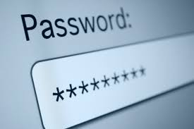
PASSWORD MANAGEMENT
Log out when finished reading your emails.
Expires every three months

Slide 14
Contact
Dr Mhaka Khoza: 022 702 3064, lindiwe.khoza@ma2.sun.ac.za
CO Du Toit: 022 702 3169, dutoit@ma2.sun.ac.za
Self-help Support Site
SU IT Help Desk: 021 808 4367

